Slide 1
Medicine Inventory
Prepared by:
Rawda Haitham 221001727
Yossr Ashraf 221001861
Malak Reda 231001933
Mariam Sayed 241001662
Yasmine Gomaa 241002181
Supervised by
Mohamed Mahmoud ElSayeh

Slide 2
introduction
A Medicine Inventory Management System is used to organize and manage medicines, prescriptions, diseases, doctors, and bills using a relational database system.
The system helps:
Store medicine information
Track prescriptions
Connect medicines with diseases
Generate bills automatically
Retrieve important data using SQL queries

Slide 3
Project Objectives
The main objectives of the project are:
Design a relational database system
Manage doctors and prescriptions
Store medicine and disease information
Generate bills automatically using triggers
Create views for easier data access
Execute simple and complex SQL queries

Slide 4
Entities and Attributes
Doctor:
DoctorID
DoctorName
Qualification
Specialization
Disease:
DiseaseID
DiseaseName
DiseaseType
Medicine:
MedicineID
MedicineName
ManufactureDate
ExpiryDate
Price
Dosage
Prescription:
PrescriptionID
DoctorID
IssueDate
PatientName
Bill:
BillID
PrescriptionID
Tax
Discount
Total

Slide 5
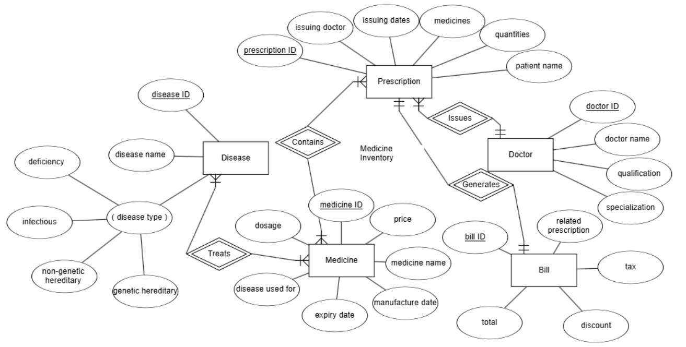
ER Diagram
The ER Diagram shows:
Entities
Relationships
Primary Keys
Foreign Keys
Cardinality Ratios

Slide 6
Relationships
Doctor → Prescription
One doctor can issue many prescriptions.
Each prescription belongs to one doctor.
Prescription ↔ Medicine
Many-to-Many relationship.
Implemented using Prescription_Medicine table.
Medicine ↔ Disease
Many-to-Many relationship.
Implemented using Medicine_Disease table.

Slide 7
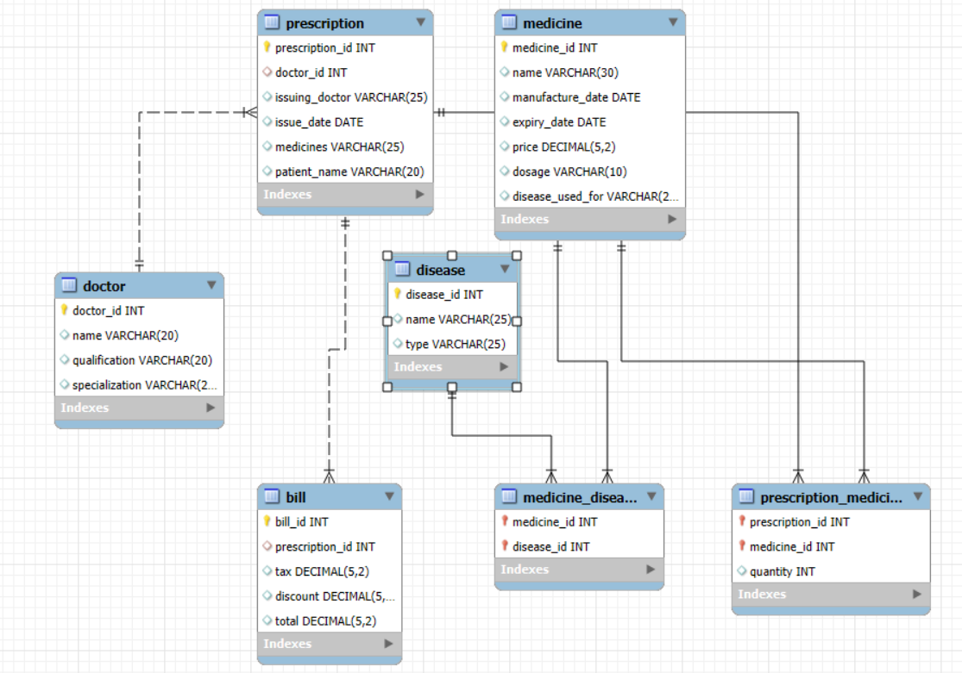
Relational Schema

Slide 8
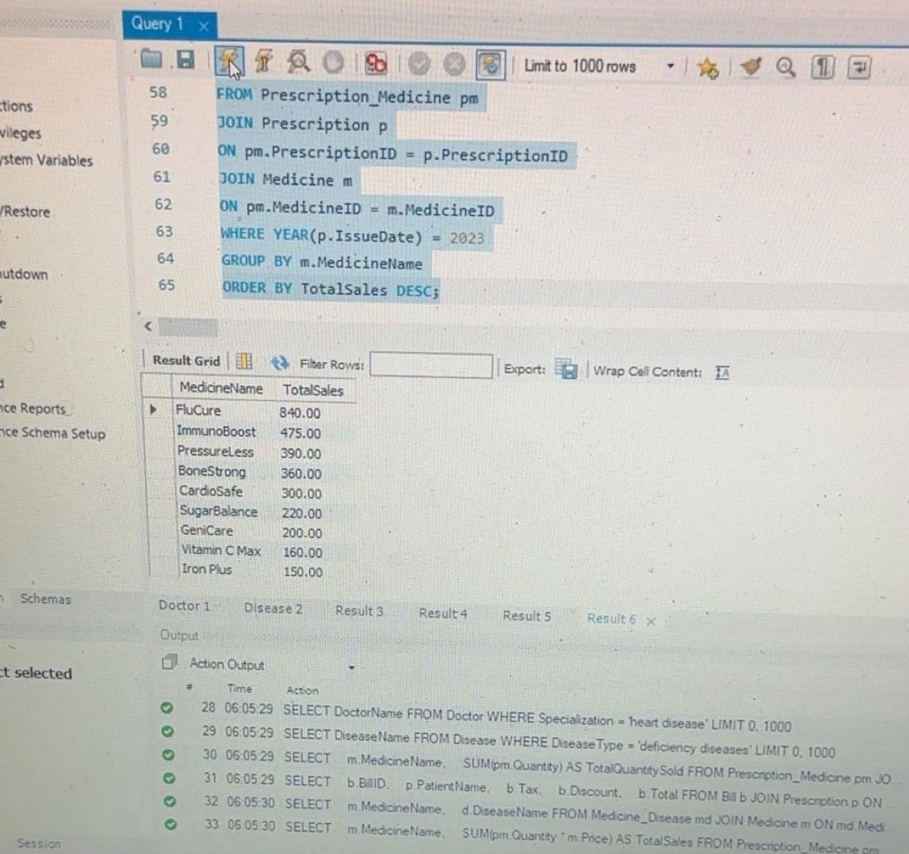
CREATE TABLE Statements
We created all database tables using SQL CREATE TABLE statements.
The tables include:
Primary Keys
Foreign Keys
Constraints
Check Conditions

Slide 9
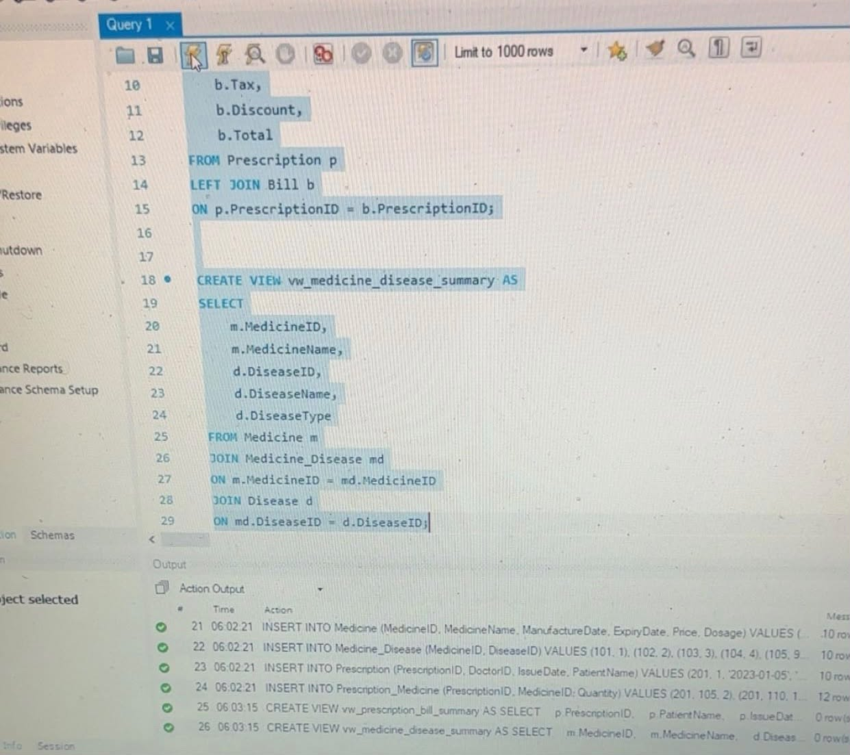
INSERT Statements
The database contains:
10 Doctors
10 Diseases
10 Medicines
10 Prescriptions
Multiple Prescription Items

Slide 10
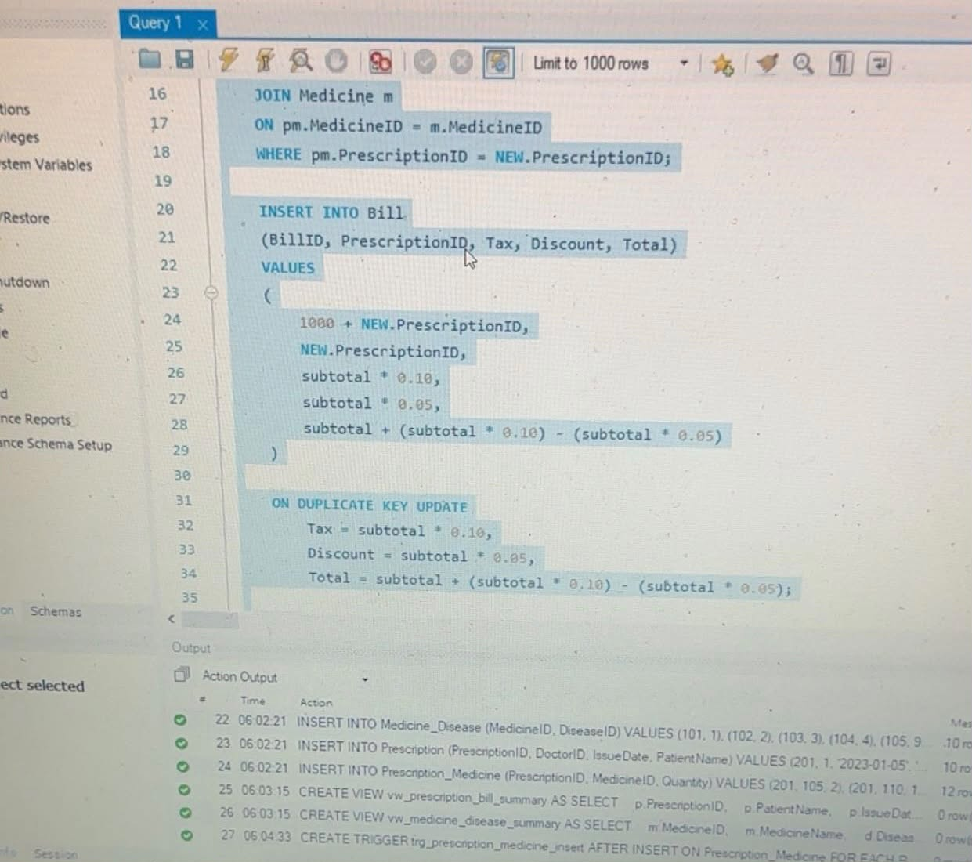
Trigger Implementation
We implemented a trigger to automatically calculate the bill whenever medicines are added to a prescription.
The trigger calculates:
Tax
Discount
Total Bill
This improves automation and reduces manual calculations.

Slide 11
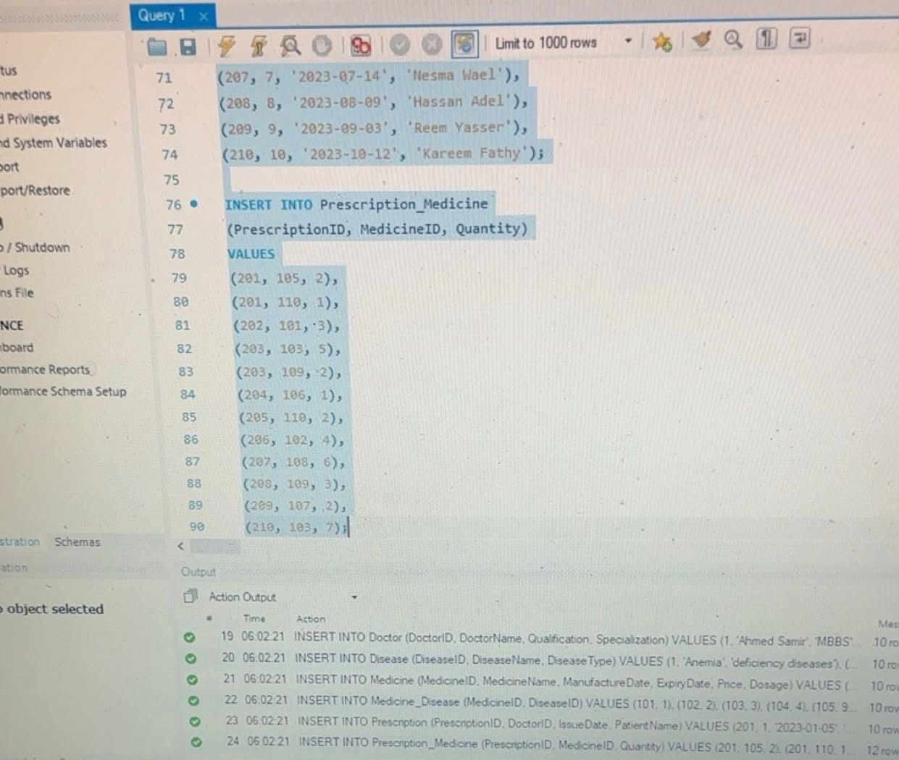
Views
vw_prescription_bill_summary
Displays:
Prescription information
Bill details
vw_medicine_disease_summary
Displays:
Medicine names
Related diseases
Views simplify complex queries and improve readability.

Slide 12
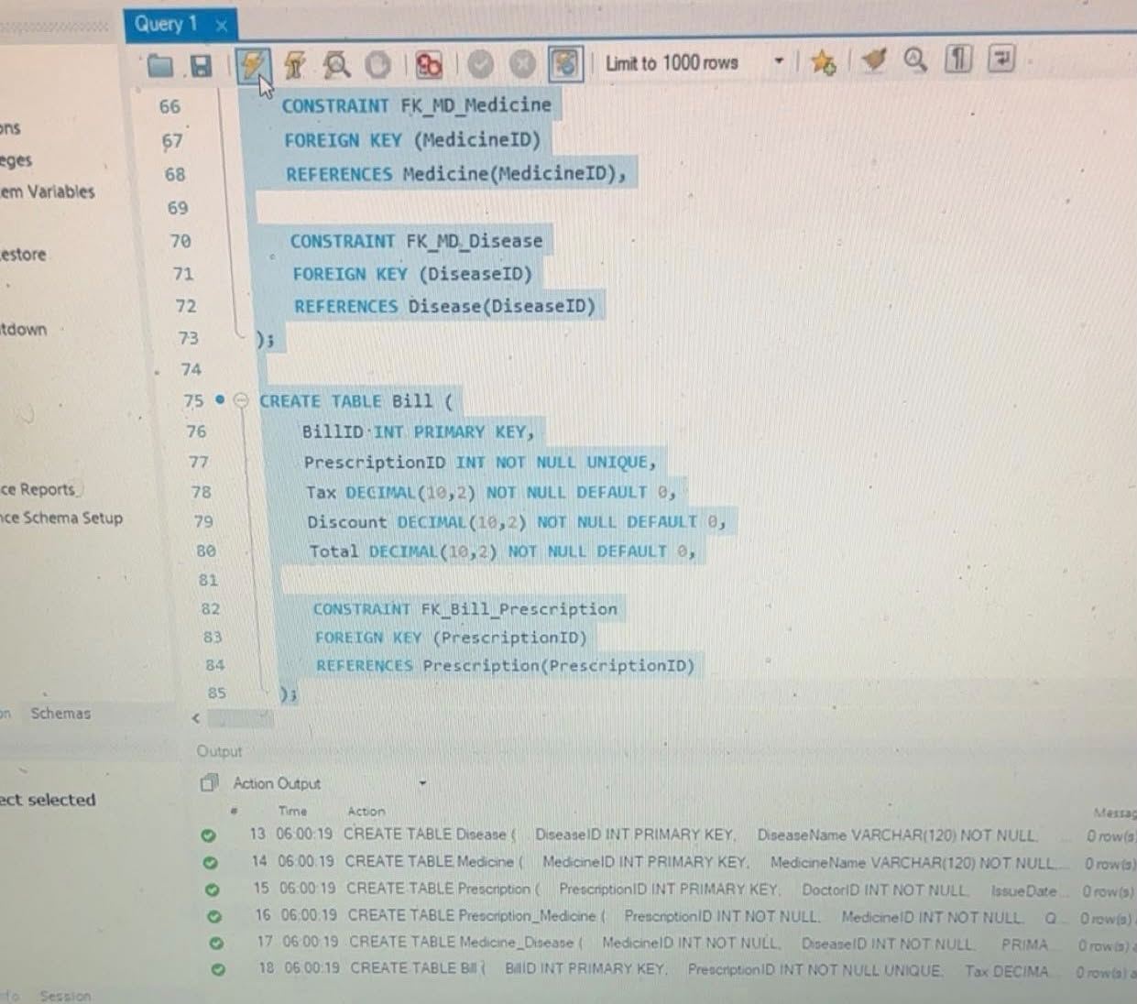
SQL Queries
Query 1
List doctors specialized in heart disease.
Query 2
List deficiency diseases.
Query 3
List the most sold medicine in 2023.

Slide 13
Additional Queries
Bills with Patient Names
Displays all bills with related patients.
Total Sales per Medicine
Calculates total medicine sales in 2023.
Medicine and Disease Information
Displays medicines and their related diseases.

Slide 14
Conclusion
In this project, we successfully designed and implemented a Medicine Inventory Management System using SQL and MySQL.
The project included:
Relational database design
ER Diagram
Tables and relationships
Triggers
Views
SQL Queries
The system helps organize medicine inventory and automate billing operations efficiently.

Slide 15
THANK YOU

